Slide 1
MA3077 (DLI) Operational Research Lecture 11 – Maximal flows and minimal cuts
Dr Marco Fasondini

Slide 2
Recapitulation and lecture outline
Summary: in the previous two lectures we learnt:
about graphs and networks
how to determine a minimal spanning tree,
how to determine a shortest path tree.
Today: Orientated networks, maximal flows, and minimal cuts, following loosely Ch. 10 of the book by Hillier and Lieberman.

Slide 3
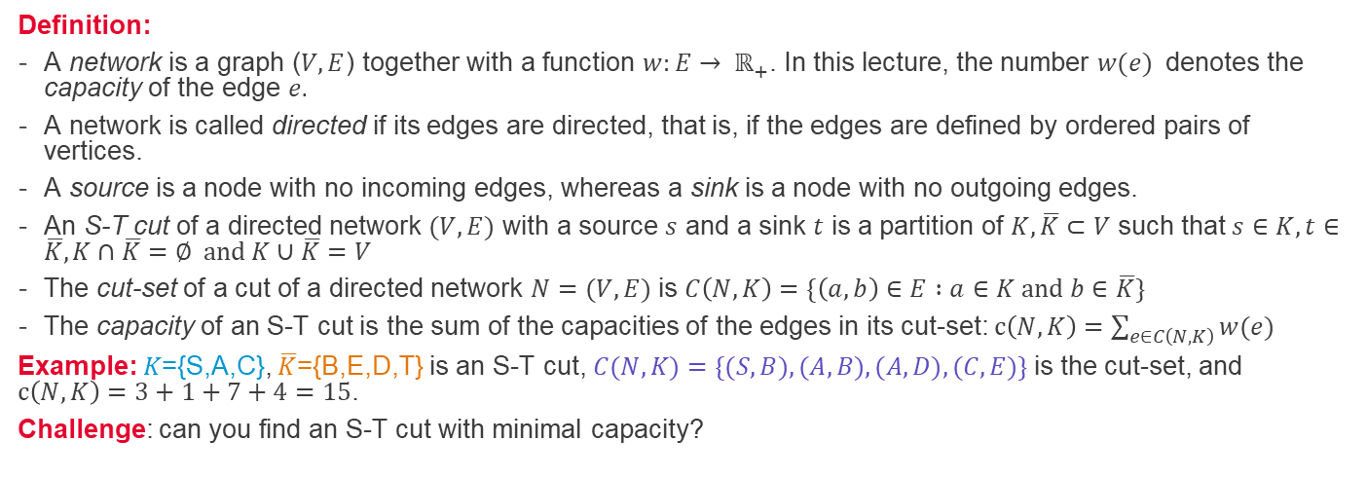
Directed networks - cuts
3
a
1
t
5
4
9
7
b
d
s
2
5
4
1
c
4
e
6
Definition:
A network is a graph ($V,E$) together with a function $w:E→ ℝ_{+}$. In this lecture, the number $w(e)$ denotes the capacity of the edge $e.$
A network is called directed if its edges are directed, that is, if the edges are defined by ordered pairs of vertices.
A source is a node with no incoming edges, whereas a sink is a node with no outgoing edges.
An S-T cut of a directed network $(V,E)$ with a source $s$ and a sink $t$ is a partition of $K, \overline{K}⊂V$ such that$s∈K, t∈\overline{K}, K∩\overline{K}=∅ and K∪\overline{K}=V$
The cut-set of a cut of a directed network $N=(V,E)$ is $C\left(N,K\right)=\{\left(a,b\right)∈E :a∈K and b∈\overline{K}\}$
The capacity of an S-T cut is the sum of the capacities of the edges in its cut-set: $c\left(N,K\right)=\sum_{e∈C\left(N,K\right)}{w(e)}$
Example: 𝐾={S,A,C}, $\overline{K}$={B,E,D,T} is an S-T cut, $C(N,K)=\{(S,B), (A,B), (A,D), (C,E)\}$is the cut-set, and $c\left(N,K\right)=3+1+7+4=15$.
Challenge: can you find an S-T cut with minimal capacity?

Slide 4
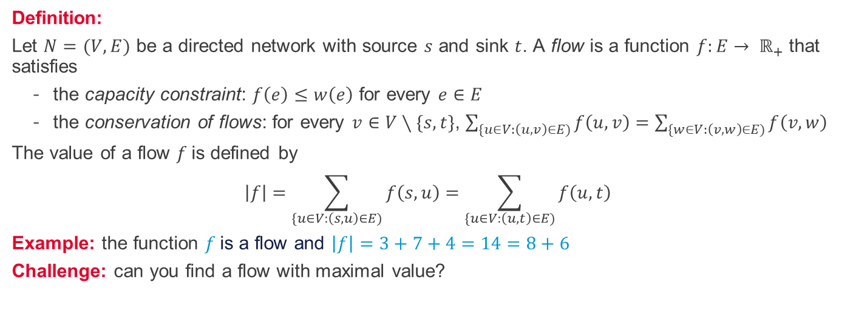
Directed networks - flows
3
a
3
3
1
8
t
5
0
4
4
9
7
7
b
d
s
2
5
1
4
0
3
1
6
4
c
4
4
e
6
Definition:
Let $N=(V,E)$ be a directed network with source $s$ and sink $t$. A flow is a function $f:E→ ℝ_{+}$ that satisfies
the capacity constraint: $f\left(e\right)≤w\left(e\right)$ for every $e∈E$
the conservation of flows: for every $v∈V∖\{s,t\}$, $\sum_{\{u∈V:\left(u,v\right)∈E)}{f\left(u,v\right)}=\sum_{\{w∈V:\left(v,w\right)∈E)}{f\left(v,w\right) }$
The value of a flow $f$is defined by
$$\left|f\right|=\sum_{\{u∈V:\left(s,u\right)∈E)}{f\left(s,u\right)}=\sum_{\{u∈V:\left(u,t\right)∈E)}{f\left(u,t\right)}$$
Example: the function $f$is a flow and $\left|f\right|=3+7+4=14=8+6$
Challenge: can you find a flow with maximal value?

Slide 5
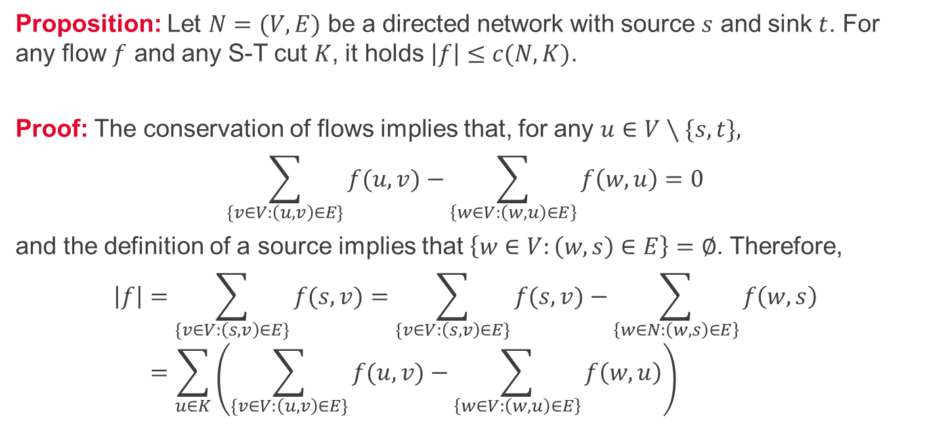
Maximal flows and minimal cuts 1/2
Proposition: Let $N=(V,E)$ be a directed network with source $s$ and sink $t$. For any flow $f$ and any S-T cut $K$, it holds $\left|f\right|≤c(N,K)$.
Proof: The conservation of flows implies that, for any $u∈V∖\{s,t\},$
$$\sum_{\{v∈V:\left(u,v\right)∈E\}}{f(u,v)}−\sum_{\left\{w∈V:\left(w,u\right)∈E\right\}}{f\left(w,u\right)}=0$$
and the definition of a source implies that $\left\{w∈V:\left(w,s\right)∈E\right\}=∅$. Therefore,
$$\left|f\right|=\sum_{\{v∈V:\left(s,v\right)∈E\}}{f(s,v)}=\sum_{\{v∈V:\left(s,v\right)∈E\}}{f(s,v)}−\sum_{\left\{w∈N:\left(w,s\right)∈E\right\}}{f\left(w,s\right)} \\ =\sum_{u∈K}{\left(\sum_{\{v∈V:\left(u,v\right)∈E\}}{f(u,v)}−\sum_{\left\{w∈V:\left(w,u\right)∈E\right\}}{f\left(w,u\right)}\right)}$$

Slide 6
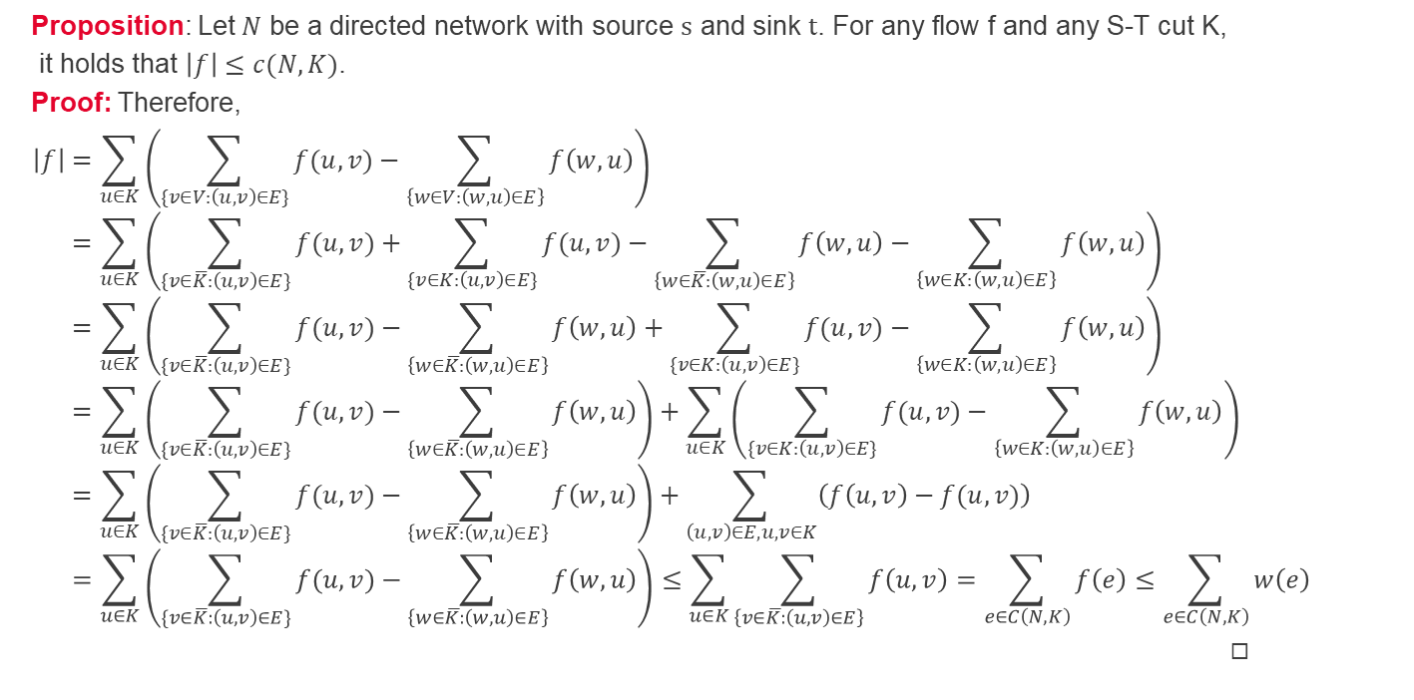
Maximal flows and minimal cuts 2/2
Proposition: Let $N$ be a directed network with source $s$ and sink $t$. For any flow f and any S-T cut K,
it holds that $\left|f\right|≤c(N,K)$.
Proof: Therefore,
$$\left|f\right|=\sum_{u∈K}{\left(\sum_{\{v∈V:\left(u,v\right)∈E\}}{f(u,v)}−\sum_{\left\{w∈V:\left(w,u\right)∈E\right\}}{f\left(w,u\right)}\right)} \\ =\sum_{u∈K}{\left(\sum_{\{v∈\overline{K}:\left(u,v\right)∈E\}}{f(u,v)}+\sum_{\{v∈K:\left(u,v\right)∈E\}}{f(u,v)}−\sum_{\left\{w∈\overline{K}:\left(w,u\right)∈E\right\}}{f\left(w,u\right)}−\sum_{\left\{w∈K:\left(w,u\right)∈E\right\}}{f\left(w,u\right)}\right)} \\ =\sum_{u∈K}{\left(\sum_{\{v∈\overline{K}:\left(u,v\right)∈E\}}{f(u,v)}−\sum_{\left\{w∈\overline{K}:\left(w,u\right)∈E\right\}}{f\left(w,u\right)}+\sum_{\{v∈K:\left(u,v\right)∈E\}}{f(u,v)}−\sum_{\left\{w∈K:\left(w,u\right)∈E\right\}}{f\left(w,u\right)}\right)} \\ =\sum_{u∈K}{\left(\sum_{\{v∈\overline{K}:\left(u,v\right)∈E\}}{f(u,v)}−\sum_{\left\{w∈\overline{K}:\left(w,u\right)∈E\right\}}{f\left(w,u\right)}\right)+\sum_{u∈K}{\left(\sum_{\{v∈K:\left(u,v\right)∈E\}}{f(u,v)}−\sum_{\left\{w∈K:\left(w,u\right)∈E\right\}}{f\left(w,u\right)}\right)}} \\ =\sum_{u∈K}{\left(\sum_{\{v∈\overline{K}:\left(u,v\right)∈E\}}{f(u,v)}−\sum_{\left\{w∈\overline{K}:\left(w,u\right)∈E\right\}}{f\left(w,u\right)}\right)+\sum_{\left(u,v\right)∈E, u,v∈K}{\left(f\left(u,v\right)−f(u,v)\right)}} \\ =\sum_{u∈K}{\left(\sum_{\{v∈\overline{K}:\left(u,v\right)∈E\}}{f(u,v)}−\sum_{\left\{w∈\overline{K}:\left(w,u\right)∈E\right\}}{f\left(w,u\right)}\right)}≤\sum_{u∈K}{\sum_{\left\{v∈\overline{K}:\left(u,v\right)∈E\right\}}{f\left(u,v\right)}}=\sum_{e∈C\left(N,K\right)}{f\left(e\right)}≤\sum_{e∈C\left(N,K\right)}{w\left(e\right)}=c\left(N,K\right).$$
◻︎

Slide 7
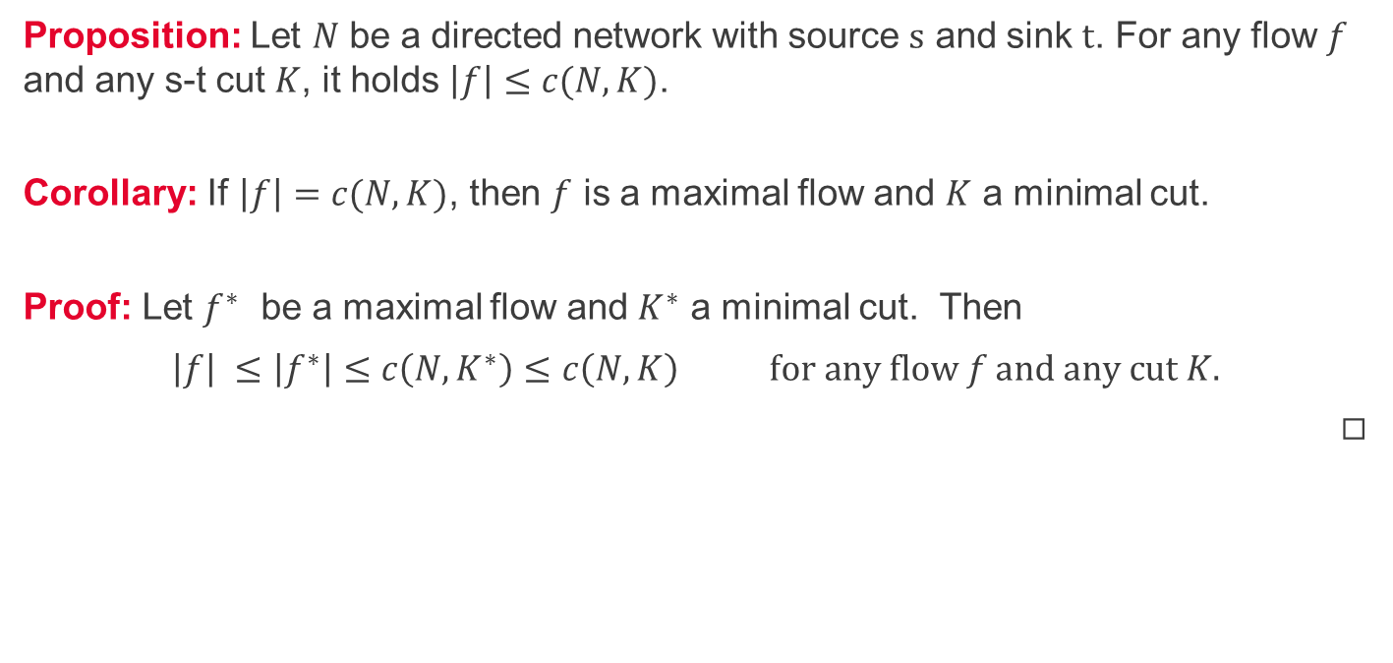
Maximal flows and minimal cuts - corollary
Proposition: Let $N$ be a directed network with source $s$ and sink $t$. For any flow $f$ and any s-t cut $K$, it holds $\left|f\right|≤c(N,K)$.
Corollary: If $\left|f\right|=c(N,K)$, then $f$ is a maximal flow and $K$ a minimal cut.
Proof: Let $f^{∗}$ be a maximal flow and $K^{∗}$ a minimal cut. Then
$\left|f\right| ≤\left|f^{∗}\right|≤c\left({N,K}^{∗}\right)≤c\left(N,K\right) for any flow f and any cut K.$
◻︎

